Slide 1
BHA Staff Education SB 5195 Template
Updated December 2021

Slide 2
Overview
New legislation has been passed that requires many licensed or certified behavioral health agencies to distribute naloxone to patients at risk of an opioid overdose.
In addition to providing naloxone in hand, clients must receive specific educational materials on harm reduction, medications for opioid use disorder, and instructions for use.

Slide 3
Learning Objectives
Define opioid use disorder (OUD)
Identify risk factors for opioid overdose
Know the facts about naloxone
Understand the process for naloxone distribution
Review patient education requirements
Develop skills for engaging patients who use drugs

Slide 4
Opioid Use Disorder (OUD)
OUD is defined as “a problematic pattern of opioid use leading to clinically significant impairment or distress” (CDC, 2021)
  Can be prescribed, diverted, or illicit opioids
  People can use opioids without meeting criteria
  Dependency on opioids is not diagnostic for OUD
  Recovery from OUD does not require abstinence from opioids
  OUD can have periods of remission and relapse
  Patients with OUD are at risk for fatal opioid overdose, even on MOUD

Slide 5
Risk Factors for Opioid Overdose
Restarting opioid use after a break or change in type/dose. This includes after leaving jail or prison, OUD remission, and hospital admissions
Mixing opioids with other sedatives
Misusing and/or diverting prescription pain medication
Using any drug not obtained from a pharmacy
Comorbid cardiac, renal, or respiratory disease
Previous history of overdose
Using opioids alone
Adapted from stopoverdose.org

Slide 6
Naloxone Review
Opioid antagonist that preferentially binds to opioid receptors
Will precipitate withdrawal symptoms in opioid dependent patients
Duration of 30-90 minutes
Overdose symptoms may return as opioid agonists re-bind to receptors
May require multiple doses (two come standard in a kit)
Can be safely administered by injection or nasal spray by trained non-medical community members
Availability decreases mortality and does not increase opioid use, risk taking behaviors, or other harms.
Adapted from WA DOH

Slide 7
Naloxone Distribution Program

Slide 8
Workflow
Inclusion Criteria/Screening Protocol
Agency’s specific distribution protocol
Patient Education
Documentation
**This slide should bullet point each element of your programs workflow, and may include sections not listed above. Following this slide each bullet point should have its’ own slide that outlines the details of your agency’s policy and protocol. **

Slide 9
Inclusion Criteria and Screening
Inclusion Criteria
  Symptoms of Opioid Use Disorder
  Reported use of opioids outside legal authority
Exceptions
  Provider clinical judgement
  Client already possesses naloxone
  Client declines naloxone
Screening Protocol or Tool
**This slide should detail the inclusion criteria and screening process determined by your organization as written in agency policy**

Slide 10
Agency Distribution Protocol
**This slide should be updated to detail the distribution steps/protocol upon positive identification including:
  How to notify or work with pharmacy as outlined in your agency’s policy

Slide 11
Sample Workflow (example)
Identify positive screen at intake (based on inclusion criteria)
Confirm that the client does not have naloxone, is appropriate in clinical judgement for a kit, and agrees/wants naloxone
Initiate pharmacy notification protocol the same day as the assessment and informs client about the timing of getting naloxone in hand (e.g., will have it at next visit, if that visit is greater than xyz, will mail to patient’s home or give client preference on how to receive).
Complete education: Clinician/staff completes education at that visit if client will get mail-order medication or completes education at time of naloxone provision (based on organization policy)
Document (same day as assessment) 1)+ screening, 2) education plan (completed or when it will be complete and requisite brochures given), 3) initiation of pharmacy protocol, 4) determined method of naloxone provision (mail order or in hand at next visit on xyz date)

Slide 12
Required Patient Education
Review
Review the overdose reversal instructions and directions for use with the client and watch video, if applicable.
Distribute
Distribute HCA Harm Reduction and Medications for OUD client brochure (or have it in AVS or via electronic portal if using telehealth)
Confirm
Confirm patient understanding and collect patient signature page, as appropriate

Slide 13
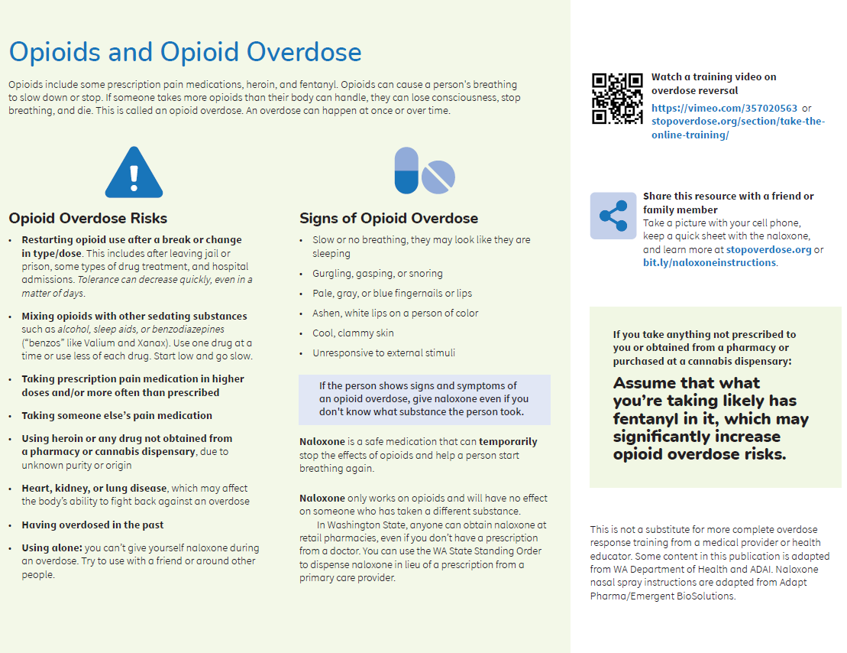
HCA Overdose Prevention & Directions for Use (Side 1/2)
Review opioid overdose risks that may be relevant to the client’s presentation or positive screening
Briefly review signs of an overdose
Tell client what naloxone does, how it works, and where to get it

Slide 14
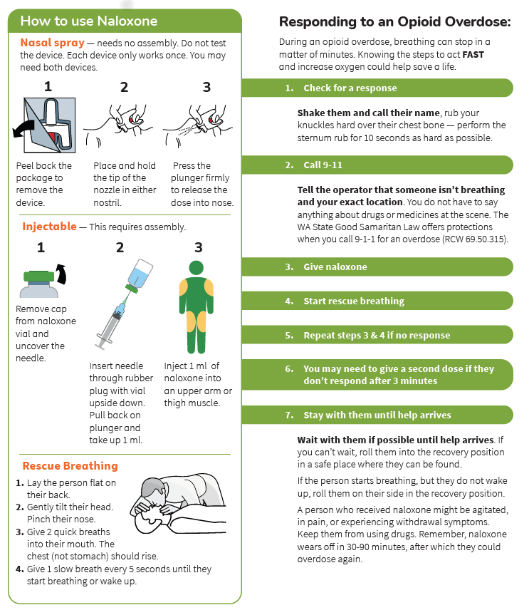
HCA Overdose Prevention & Directions for Use
(Side 2/2)
Review:
How to recognize and respond to an overdose
How to administer naloxone
Potential for withdrawal symptoms (if opioid dependent)
Potential for return of overdose symptoms
Need for observation and medical care
Importance of not using opioids immediately after naloxone
Good Samaritan laws

Slide 15
HCA Overdose Prevention & Directions for Use resources
QR Code and URL to training video for clients
Best practice: talk to clients about keeping naloxone in a designated place or on them with this paperwork. Mention the importance of sharing this information with friends, family, or people who may need to help reverse an overdose

Slide 16
Client Education Video
WA Department of Health Opioid Overdose video
Opioid Overdose - Administering Naloxone on Vimeo
Short link: https://vimeo.com/357020563
**this slide should contain any additional videos or training materials for staff. It may be helpful to play this for staff education as well during the training.

Slide 17
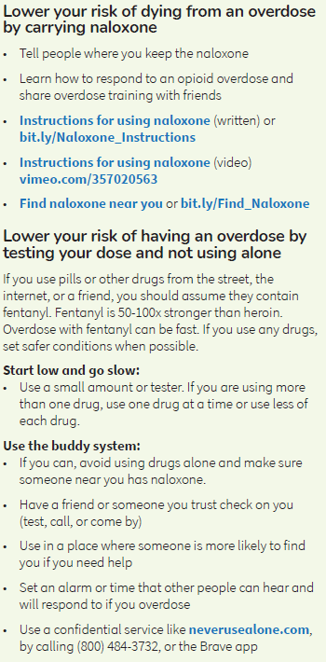
HCA Harm Reduction and Medications for OUD:
Harm Reduction Strategies
Relevant to client presentation, review or highlight harm reduction strategies to stay safe
Highlight strengths: reinforce what, if anything, the client is already doing to make positive changes or for expressing interest in positive change behaviors

Slide 18
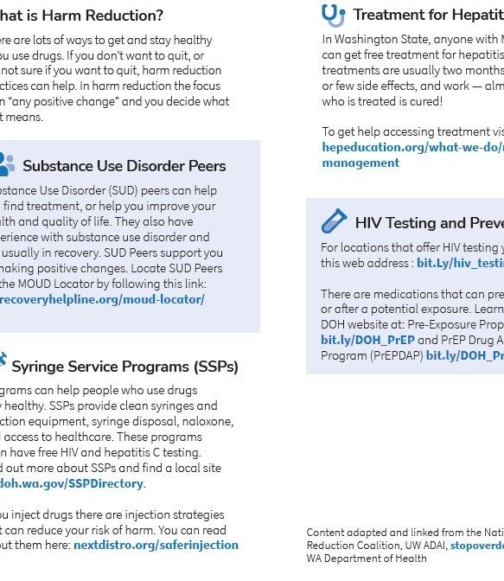
HCA Harm Reduction and Medications for OUD:
Harm Reduction Services
Review available harm reduction services and resources for treatment
Highlight Resources: WA Recovery Helpline is a central resource for treatment, peer support, locating MOUD and more; WA DOH resources

Slide 19
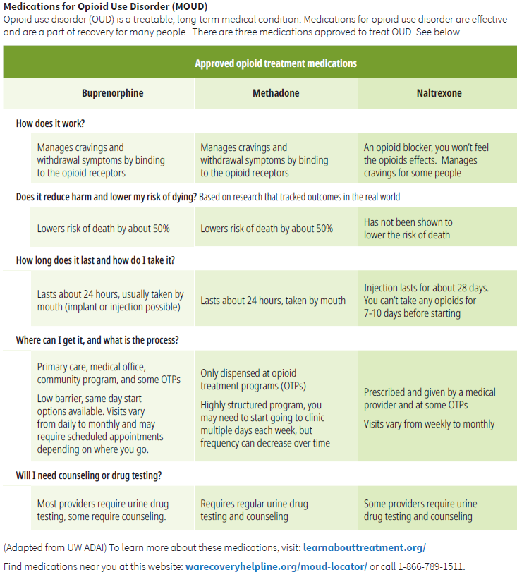
HCA Harm Reduction and Medications for OUD:
MOUD
Review three approved medications for OUD
Highlight Resources and options: WA Recovery Helpline MOUD locator, learnabouttreatment.org/

Slide 20
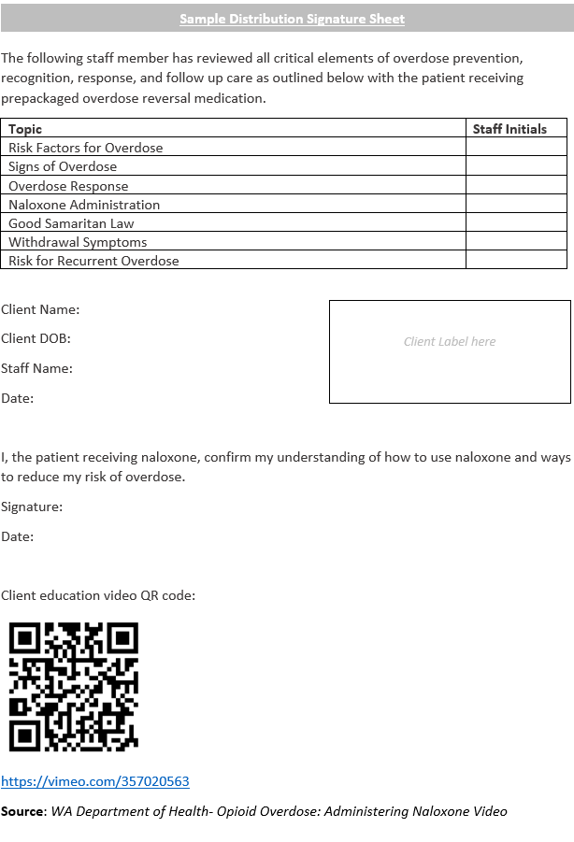
Optional Sample Distribution Signature Sheet
**If your agency decides to use this signature sheet, take time to review procedure with staff as outlined in your policy

Slide 21
Documentation Requirements
**This slide should include details about your EHR build, smart phrases, paper forms, etc.**

Slide 22
Engaging and supporting people who use drugs

Slide 23
“First, Do No Harm”
Caring for patients who use drugs requires that we recognize that the stigmatization of people who use drugs in hospital settings is costly, contributing to avoidance of timely treatment, progression of disease, patients receiving sub-standard care leaving against medical advice, and reducing access to treatment that can prevent or reverse fatal overdoses.
Evidence based treatment and prevention strategies, such as naloxone distribution, are one way to provide standard of care treatment to people who use drugs. To provide equitable care to this population we must provide this care appropriately and without bias.

Slide 24
Moving Through Judgement
Most people have opinions, thoughts, and feelings about drug use, and that includes healthcare workers. Many people have negative reactions to the idea of drug use based in social norms, personal experience with substance use or loved ones with substance use disorder, or the lack of adequate resources and training provided for the care of people who use drugs.
Accepting and understanding these reactions is an important part of ensuring they do not impact the quality of care that you provide.

Slide 25
Myths about Drug Use
Some of the negative reactions people have to drug use is due to incorrect information that is widely accepted as true. Myths include:
  People who use drugs have no desire to make positive change or reduce their use
  People who use drugs lie about their pain
  People need to “hit bottom” in order to get better, providing compassionate care will only enable them to use more
  People who use drugs should stop using before being able to receive medical care, housing, or other services
  Medications for opioid use disorder are not effective treatment, just another way to get high
  Adapted from Public Health Seattle- King County

Slide 26
Facts about Drug Use
Correct information about drug use is supported by research and is evidence based. Facts include:
  Medications for OUD (methadone and suboxone) reduce mortality by 50%*
  People who receive harm reduction services such as low-barrier housing, syringe exchange, and naloxone are more likely to recover
  The majority of people who use drugs do not develop substance use disorder
  The majority of people with substance use disorder recover
  People who use drugs have a legal and a human right to receive standard care, including access to medication for OUD, naloxone, and effective pain management
  *Learnabouttreatment.org

Slide 27
Language Matters
The words you use matter. It is important to see your patient as a person, and not as an illness or a behavior.
You can build rapport by being non-judgmental, asking open ended questions, and respecting your patient’s autonomy.
Adapted from Public Health Seattle- King County
Terms to Avoid | Replace with:
Addict, user, junkie, drug seeker | Person who uses drugs, patient
Drug abuse, drug addiction, habit | Drug use, drug misuse
Clean | Person in recovery, abstinent

Slide 28
Defining Recovery
Recovery is defined by SAMHSA as “A process of change through which individuals improve their health and wellness, live a self-directed life, and strive to reach their full potential.” (SAMHSA, 2014)
Recovery from substance use disorder mirrors recovery from any other chronic illness. Recovery starts by making incremental positive changes and can include periods of remission (relapses). Positive change includes carrying naloxone, practicing safer injection techniques, reducing use, initiating MOUD, or developing a trusting relationship with a healthcare provider.

Slide 29
Sample Engagement Approach
Step 1 - Build rapport | I would like to take some time to talk about your risk of opioid overdose and naloxone. Can you tell me what you know about naloxone and how to use it?
Step 2 – List “Pros and Cons” | What do you do that might put you at risk for overdose? What actions do you currently take to reduce that risk?
Step 3 - Provide information and get feedback | I have some additional information on overdose risk and how naloxone works, can we review it together?
Step 4 - Assess readiness for intervention | So, on a scale of 0 to 10, how prepared do you feel to use naloxone / recognize an overdose / tell other people how to use it on you / etc.
Step 5 - Make an action plan | Based on our conversation, what are some options that might work for you to help you stay healthy and safe? What supports do you have for making this change? Those are great ideas. I have a few more that be helpful (link to additional support, programs, telling people where the naloxone is stored, etc)
Adapted from http://www.bu.edu/bniart/

Slide 30
Wrap-Up
**summarize, additional staff requirements (test, competency, eval, etc), implementation timeline, other relevant information**

Slide 31
Questions?

