Slide 1
RebateWeb for Drug Makers Basic 101
Washington Pharmacy Point of Sale (POS) Module Replacement Project

Slide 2
Revision History
Version | Date | Description | Author(s)
0.1 | 09/01/2022 | Initial draft created for the Washington Pharmacy Point of Sale (POS) Module Replacement Project. | Conduent Team
0.2 | 11/10/2022 | Peer Review complete. | Phillip Heimer
0.3 | 11/11/2022 | Document Quality Review complete. | Heidi Gray
1.0 | 11/14/2022 | Addressed comments and made necessary revisions. Prepared document for HCA delivery. | Conduent Team
2.0 | 03/10/2023 | Addressed HCA comments for deliverable approval. | Conduent Team
3.0 | 06/29/2023 | Updated based on UAT training. Added Live System Demonstration videos or links. | Conduent Team
4.0 | 09/26/2023 | Added text box regarding “_Atlanta” invoice file name to slides with sample invoices (Slides 28, 29, and 30). | Conduent Team
5.0 | 01/24/2024 | Revisions based on 01/08/2204 training session. Updated enrollment for existing vs new users including CMS registration (slides 9 &10); quarter for which invoice will be active in RebateWeb (slide 6), invoice timestamp date (slide 9 & 29). | Conduent Team
6.0 | 01/25/2024 | Revisions based on 01/25/2024 training session. Removed UAT link from slide 11. Added information about CMS and how to contact RebateWeb administrator to slides 9 & 10. | Conduent Team
7.0 | 02/12/2024 | Revised for accessibility. Removed CMS link/content on slide 10. | Conduent Team

Slide 3
Objectives
When you complete this training, you should be able to:
Describe purpose of RebateWeb
Enroll in RebateWeb
Log in to RebateWeb
Navigate RebateWeb
Search for invoices
Download and print invoices

Slide 4
Agenda
Topic One: What is RebateWeb?
Topic Two: How a Manufacturer Enrolls in RebateWeb
Topic Three: Login
Topic Four: Navigation
Topic Five: Search Invoices
Topic Six: Download and Print Invoices
Recap
Contact Information

Slide 5
Topic One: What is RebateWeb?

Slide 6
What is RebateWeb?
RebateWeb is a secure internet portal that quickly and efficiently transports Drug Rebate Program invoice files to manufacturers (drug makers).
Manufacturers can view, download, and print invoices in multiple formats.
By using RebateWeb, invoice turnaround time is decreased.
Note: After system go-live,
WA manufacturer invoices for Quarter 1 2024 onward will only be available
via RebateWeb.

Slide 7
Key Process Outside of RebateWeb Tool
Disputes
HCA has a dedicated email box for dispute-based Claim Level Detail (CLD) requests only. Please submit dispute claims to the following
wadrdisputes@hca.wa.gov

Slide 8
Topic Two: How a Manufacturer Enrolls in RebateWeb

Slide 9
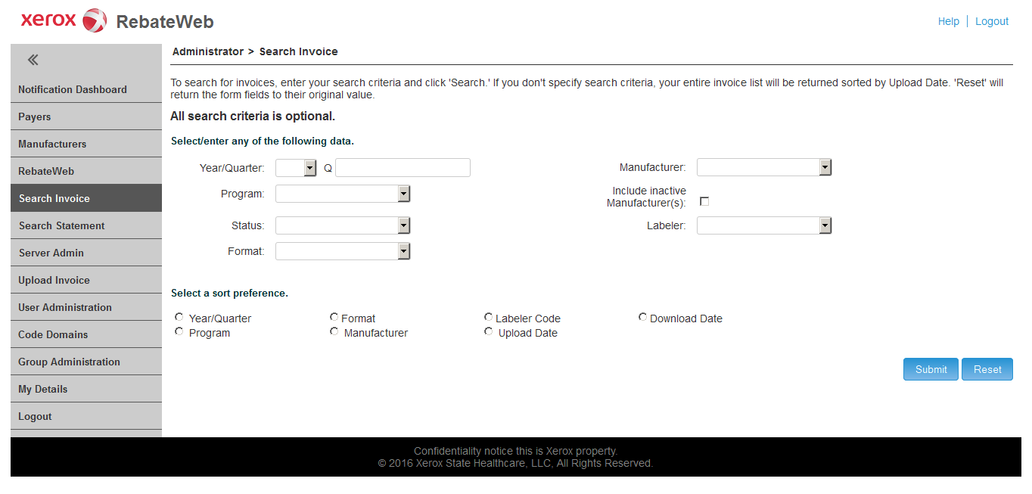
RebateWeb Enrollment Process - Existing Users
No enrollment is necessary. Access RebateWeb using your ID/Password.
WA Rebate Programs will be automatically loaded for existing RebateWeb users. To view/download Washington invoices, select applicable WA Rebate Program.
Use CMS’ Manufacturer Contact Change Form (CMS 367(d)) to make any changes to CMS Invoice Contact information. Submit the completed CMS-367d form via email to MDP@cms.hhs.gov.
Submit questions about the RebateWeb
application to the Conduent
RebateWeb Administrator at:
Rebate.WebAdmin@conduent.com
Note: The invoice upload date will serve as the timestamp/date received (post mark) for manufacturers.

Slide 10
RebateWeb Enrollment Process - New Users
If you are new to RebateWeb, follow the RebateWeb registration steps in the following slides to receive RebateWeb login credentials.
Please complete RebateWeb Registration by 04/01/2024 to ensure timely receipt of login credentials.
Submit questions about the RebateWeb application or registration to the Conduent RebateWeb Administrator at: Rebate.WebAdmin@conduent.com

Slide 11
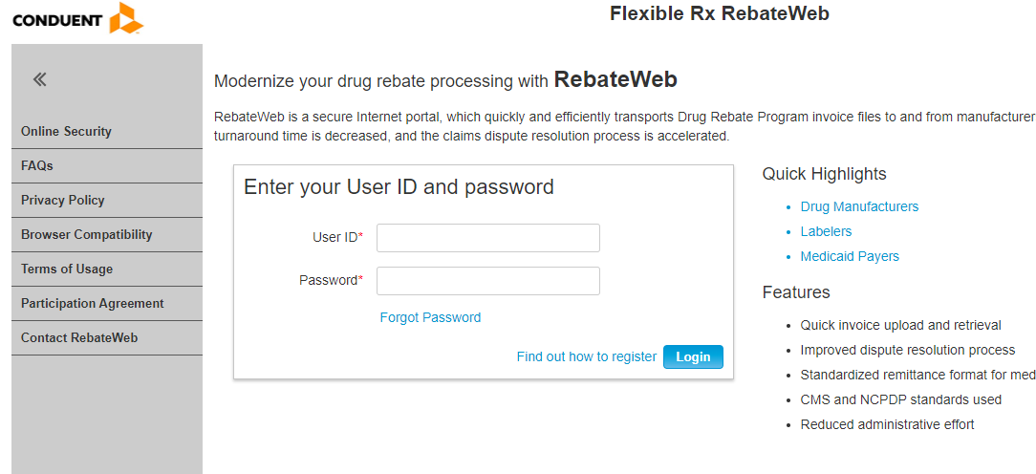
RebateWeb Registration
For manufacturers not enrolled in RebateWeb, follow these registration steps.
Go to the RebateWeb login page Login Page (drugrebate.com).
Click the “Find out how to register” link.

Slide 12
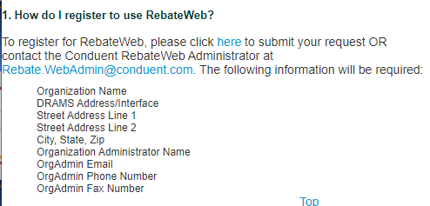
RebateWeb Registration Cont’d
3. Click blue here link to enter registration information.
4. Complete the requested information (see next slide).
NOTE: Fields with a red “*” are required.

Slide 13
Registration Form

Slide 14
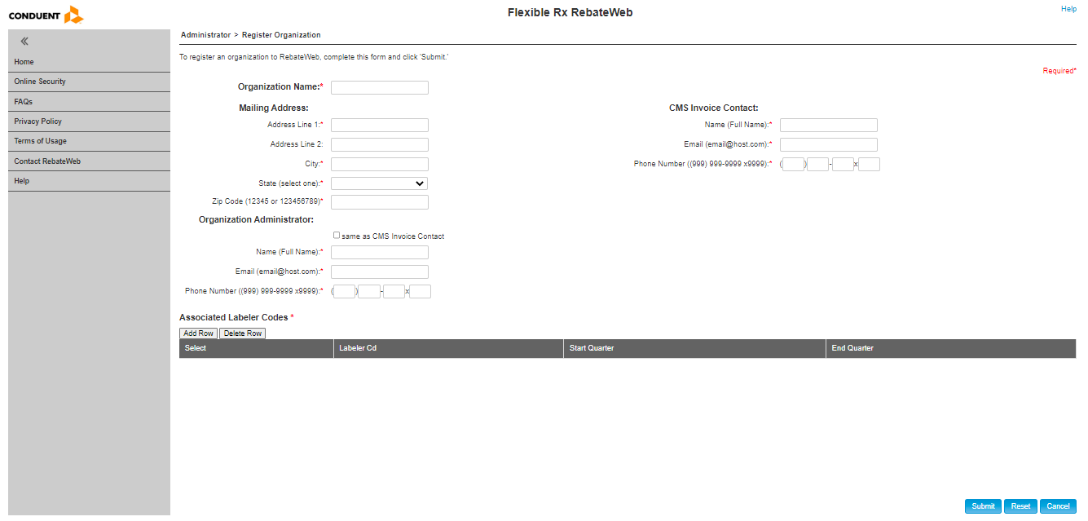
Submit Registration
5. Complete all required fields (including Associated Labeler Codes) then click Submit.
6. The RebateWeb Administrator verifies the manufacturer information then activates the account. At this point two emails are automatically sent: one with a user ID and additional instructions, and another with a temporary password (you will need to change your password upon initial login).
Check
“Same as CMS Invoice Contact”

Slide 15
RebateWeb: Live System Demonstration
Registration
Notes:
Video will be inserted here for CBT

Slide 16
Topic Three: Login

Slide 17
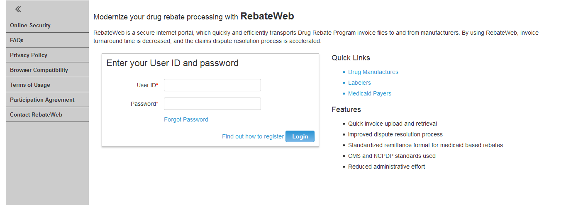
RebateWeb Login Screen
Go the RebateWeb login page: Login Page (drugrebate.com)
Type your user ID in the ‘User ID’ text box.
Type your password in the ‘Password’ text box.
Click Login.
Result: The RebateWeb homepage opens.
RebateWeb Login page:
www.drugrebate.com/RebateWeb/login.do

Slide 18
Topic Four: Navigation

Slide 19
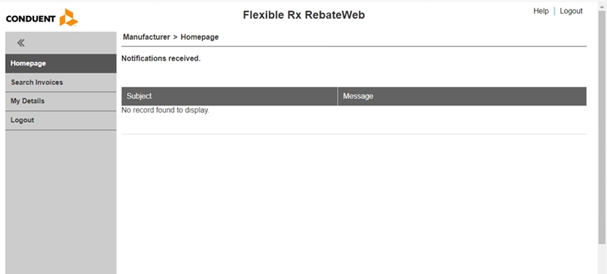
RebateWeb Homepage – Download Only User
From the RebateWeb homepage a Download Only user can:
Search Invoices
View User Details (My Details)
Logout

Slide 20
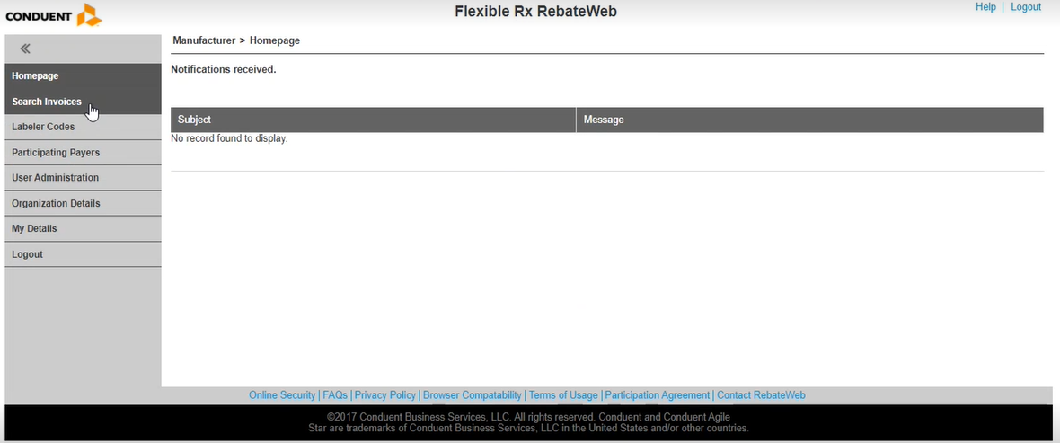
RebateWeb Homepage - Administrator
From the RebateWeb homepage an Administrator user can:
Search Invoices
View Labeler Codes
View Participating Payers
View Users
View Organization Details
View User Details (My Details)
Logout

Slide 21
Help and FAQs
Access the Help menu or Frequently Asked Questions (FAQs) from any screen in RebateWeb.

Slide 22
RebateWeb: Live System Demo Login & Navigation
Login and Navigation
Notes:
Video will be inserted here for CBT

Slide 23
Topic Five: Search Invoices

Slide 24
Search Invoices
Home Page > Search Invoices
From the home page, click Search Invoices.

Slide 25
Search Criteria
Home Page > Search Invoices > Search Invoice page
To retrieve all uploaded invoices, complete Year/Quarter and Manufacturer fields only.
Search by a variety of criteria:
Year/Quarter
Program
Status
Format
Manufacturer
Labeler
Use the “Program” field to limit your search to a specific State Drug Program.
Notes:
Program = Medicaid

Slide 26
Search Steps
Home Page > Search Invoices > Search Invoice page
Enter search criteria.
Select a sort preference.
Click Submit.
1
2
3

Slide 27
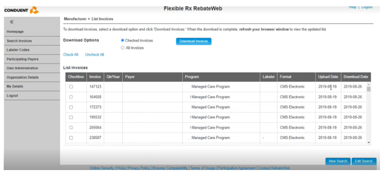
Search Results
Home Page > Search Invoices > Search Invoice page > List Invoices page
Search results are displayed as requested.
From this screen a user can:
Download invoices
Conduct a new search
Edit current search criteria

Slide 28
Topic Six: Download and Print Invoices

Slide 29
Invoice File Formats
Note: The invoice upload date will serve as the timestamp/date received (post mark) date for manufacturers.
Each invoice is available in three file formats:
CMS Electronic
This is a text file that can easily be input to other software.
NCPDP Claims Own
This format follows standards developed by the National Council of Prescription Drug Programs and includes a row per claim (includes claim level detail). These files are therefore much larger than the files in other formats and may prove unwieldy for manufacturers with large volumes of claims.
Print Image
This format is a PDF version of the invoice. You can print this yourself or read it on your computer as you choose.

Slide 30
Download and Print Invoices
Home Page > Search Invoices > Search Invoice page > List Invoices page
From the List Invoices page, select the invoices to download.
Select Download Option
Checked Invoices (select checkbox next to invoices to download)
All Invoices
Click Download Invoices button.
Follow download prompts and save the .zip file locally to open, view, and print.
2
1
Three formats available:
CMS Electronic
NCPDP Claims Own
Print Image
Note: Due to the name of the RebateWeb server, ALL invoice file names end with “_Atlanta” regardless of which state’s invoice data is displayed for the drug manufacturer.

Slide 31
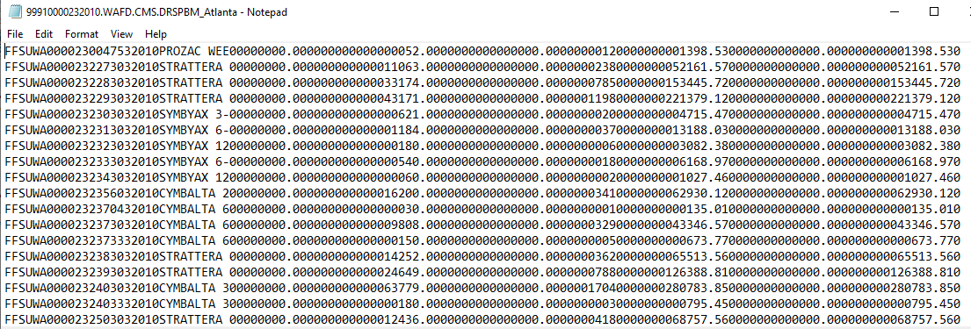
Sample Invoice – CMS Electronic
This invoice is a text file that can easily be input to other software.
Note:
Due to the name of the RebateWeb server, ALL invoice file names end with “_Atlanta” regardless of which state’s invoice data is displayed for the drug manufacturer.

Slide 32
Sample Invoice – NCPDP Claims Own
This invoice format follows standards developed by the National Council of Prescription Drug Programs (NCPDP) and includes a row per claim (includes claim level detail).
Note:
Due to the name of the RebateWeb server, ALL invoice file names end with “_Atlanta” regardless of which state’s invoice data is displayed for the drug manufacturer.

Slide 33
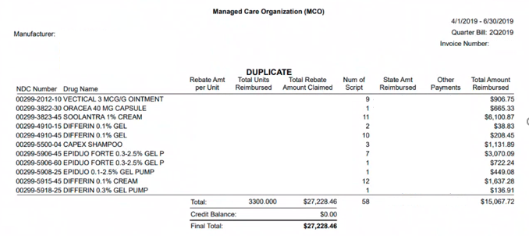
Sample Invoice – Print Image
Invoice includes:
Drugs
Units
Units Reimbursed
Amount Claimed
Number of Scripts
State Amount
Reimbursed
Other Payments
Total Amount
Reimbursed
The file also includes a cover letter with information such as total owed and how to make payment.

Slide 34
RebateWeb: Live System Demo Search and Download Invoices
Search Invoices
Download / Print Invoices
Notes:
Video will be inserted here for CBT

Slide 35
Recap

Slide 36
Recap of Training
You should now be able to:
Describe RebateWeb functionality
Register for RebateWeb
Log in and navigate RebateWeb
Search, view, download, and print invoices
Describe the three invoice file formats

Slide 37
Questions?
Submit question about the RebateWeb application to the Conduent RebateWeb Administrator at:
Rebate.WebAdmin@conduent.com

Slide 38
Training Survey
Please take a few moments to participate in our survey and help us improve your training experience!
To access the survey, move your cursor to the picture on right. With the cursor stationary over the picture, press the <Ctrl> key until the cursor changes to the selection tool.
<Left Click> on the picture. The survey will open in a separate window on the screen

Slide 39
Contact Information

Slide 40
Contacts
Submit questions regarding the content in this training to:
WATrainer@Conduent.com
Submit questions about the RebateWeb application to the Conduent RebateWeb Administrator at:
Rebate.WebAdmin@conduent.com
Also see the Training FAQs in SharePoint

Slide 41
End of the Presentation

