Slide 1
Provider’s Guide on How to Bill for Sign Language Reimbursement
JoAnna Gaffney/Kathy Templet/Destiney Hodge
Program Specialists
Medicaid Program Division
June 2021

Slide 2
HCA Reimbursement Policy for Sign Language Interpreter Requests
The Health Care Authority (HCA) will provide reimbursement for sign language interpreter requests submitted through the ODHH online request form. This process is used when ODHH is unable to secure an interpreter for the Apple Health client’s appointment. Reimbursement will be paid at the current ODHH rate. Mileage, travel time, toll fees, and parking will be paid at the incurred rate.

Slide 3
Reimbursement Training Objectives
Objectives:
Which requests are eligible for reimbursement?
Which requests are not eligible for reimbursement?
How much will I be reimbursed?
How do I cancel a request?
How do I request reimbursement?
Step by step entry for reimbursement claim submission.

Slide 4
Provider Responsibility
According to Title VI of the Civil Rights Acts of 1964 and the Americans with Disabilities Act (ADA), providers are required to assure language access. HCA supports you in this effort by offering interpreter services through our contractors.
If HCA’s interpreter services contractors are unable to provide an interpreter, providers are responsible to provide an interpreter at their expense.

Slide 5
Which Requests are Eligible for Reimbursement?
HCA will only reimburse providers for pre-scheduled requests submitted through ODHH online request form prior to the appointment. Claims for reimbursement must be submitted within 90 days from the date of service, include a prior authorization reference number, ODHH service request number and meet the below criteria:
Request was unable to be filled by ODHH contractor
Request follow ODHH Master contract guidelines
Eligible health care services
Medicaid-eligible clients
Medicaid-enrolled providers
Completed appointments

Slide 6
Which Requests are not Eligible for Reimbursement?
Apple Health Medicaid does not pay or reimburse for interpreter services when:
The request was not submitted to through the ODHH online request form prior to the appointment.
The interpreter is a member of the client’s family.
The client is receiving inpatient and/or hospital service.
The client is receiving nursing facility services.
The provider is a public health agency or hospital.
The interpreting is providing administrative services, including but not limited to:
Scheduling appointments
Appointment reminder calls
Miscellaneous office or bookkeeping tasks

Slide 7
How Much Will I be Reimbursed?
Interpreter rates are reimbursed at the full rate posted on the Office of Deaf and Hard of Hearing Sign language Interpreter rates website
Any expense that exceeds the established reimbursement rate will not be covered. Providers are responsible for paying the difference.
Mileage, travel time and toll fees are reimbursed at the cost incurred.

Slide 8
How do I Cancel a Request?
If ODHH is unable to fill your interpreter request within your timeframe, proceed with the following for reimbursement:
Cancel your request with the ODHH contractor
If you need to cancel a request, you must email the contractor and include:
1. Service Request (SR) number you are cancelling
2. Reason for the cancellation
Note: If you cancel a request that has been filled by an interpreter you will not be eligible for reimbursement

Slide 9
How Do I Request Reimbursement?
Once you secure your own interpreter and pay for their services, you will need to :
Email HCA Interpreter Services at INTERPRETERSVCS@hca.wa.gov
a. Subject line of email must read: Reimbursement Request
b. Body of email must include:
i. SR number of request you have canceled
ii. Date of the appointment
iii. Attach a copy of the paid invoice which must include:
1. Interpreter name
2. Date/Time of service
3. Total paid amount (include travel time
and amounts for mileage, parking fees, ferry and toll fees)

Slide 10
What Do I Do Once I receive Approval for Reimbursement?
Once HCA has sent a confirmation email that the request was approved:
Provider is free to submit a ProviderOne reimbursement claim. This claim will be paid up to ODHH rates. The provider must know the prior authorization number (PA).
Upload a copy of the paid interpreter invoice to the reimbursement claim as well as proof of mileage, parking fees, ferry and toll fees.

Slide 11
How to Bill a Claim in ProviderOne
ProviderOne is used by Washington Apple Health providers to submit claims and manage their provider accounts. It is compatible with the most commonly used internet browsers: Google Chrome, Firefox, Microsoft Edge, Internet Explorer (IE) for Windows, and Safari for Windows and MAC.
In order for ProviderOne to work on your computer, verify your browser allows popups, as these are vital to successful claims submission.

Slide 12
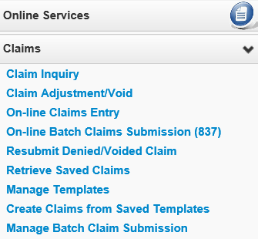
Claim Submission
From the Provider Portal, select the Online Claims Entry option located under the Claims heading.

Slide 13
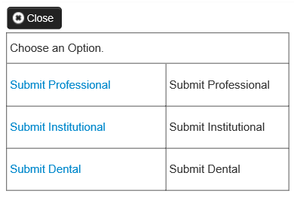
Claim Submission
Select the Submit Professional option.

Slide 14
Claim Level: Billing Provider Details
The Billing Provider Information of the claim screen is where the provider billing specifics will be entered. The sign language taxonomy code must be used on reimbursement claims.
171R00000X
Note: The claim will deny if the sign language taxonomy code 171R00000X is not entered on this screen.
14

Slide 15
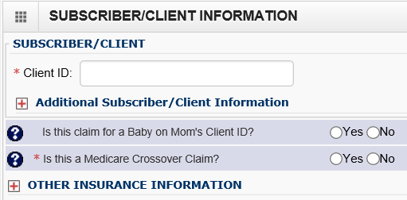
Claim Level: Subscriber/Client Details
The Subscriber/Client Information section is designated for the client information of the patient that is receiving services.
Answer “no” to the below questions:
Is the claim for a baby on mom’s client ID?
Is this a Medicare Crossover Claim? Answer is always No
The “Other Insurance Information” section can be skipped as it is not needed for sign language billing.

Slide 16
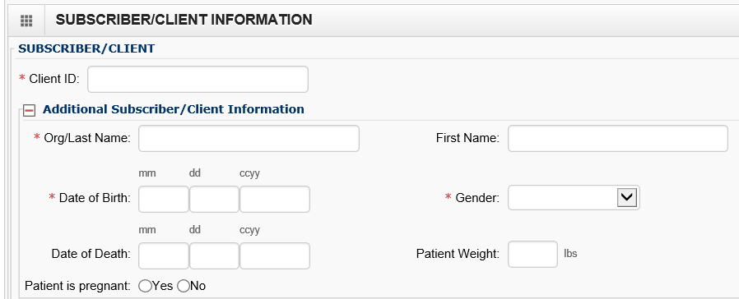
Claim Level: Subscriber/Client Details
Once the field is expanded enter the Patient’s Last Name, Date of Birth, and Gender. These are required fields.
The date of birth must be in the following format: MM/DD/CCYY.

Slide 17
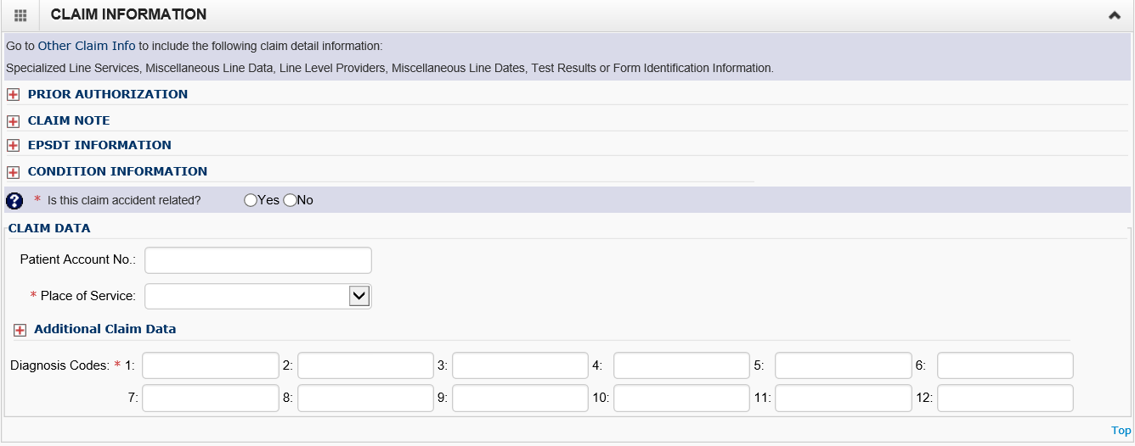
Claim Level: Claim Information Section
Z710

Slide 18
Claim Level: Prior Authorization
Click on the red (+) expander to open the Prior Authorization section.
Enter the approved Prior Authorization Number. This is a required field for sign language claims.
18

Slide 19
Claim Level: Claim Note, EPSDT Information, Condition Information
All of these areas should be skipped as they are not needed for sign language billing.
19

Slide 20
Claim Level: Is this claim accident related?
This question will always be answered No

Slide 21
Claim Level: Patient Account Number
The Patient Account No. You have the option to enter an internal patient account number number that will be included in the Remittance and Status Report (RA)
The Place of Service code is required. For sign language billing you will choose either option 11-OFFICE or 12-HOME.
21

Slide 22
Claim Level: Diagnosis Codes
Diagnosis code Z710 is the only code used for sign language billing. Enter this diagnosis in box 1 of the diagnosis area.
Enter this diagnosis without a decimal point.

Slide 23
Line Level: Service Dates and Place
Enter the Service Date To and From and Service Date To fields. This should match the date of the appointment on the Master Interpreter Request Form for Medical.
The dates of service must be entered in the following format: MM/DD/CCYY
The Place of Service code is optional at the service line level as it was previously entered. For sign language billing you will choose:
11-OFFICE
12-HOME
23

Slide 24
Line Level: Procedure Code
Enter the Procedure Code.
The following procedure codes that will be used for sign language billing are:
T1013 – Sign Language Interpreter Services
S0215 – Mileage
A0170 – Parking Fees/Tolls
T2024 – Agency ONLY Finder’s Fee

Slide 25
Line Level: Modifiers
When billing for sign language codes or services related to sign language the U3 modifiers is required with each code.
Enter the appropriate 2 digit modifier(s) in the Modifiers box.
First modifier will always be U3
Additional modifiers may include:
Modifier U8 for behavioral health or
Modifier U9 for substance abuse disorder (SUD)
Modifier 52 for cancelled appointment
Note: 52 modifier will always be the last modifier in a series
25

Slide 26
Line Level: Submitted Charges and Diagnosis Pointers
Enter the Submitted Charges.
If the dollar amount is a whole number, no decimal point is needed.
For the sign language billing, choose the number 1 from the Diagnosis Pointer dropdown box 1.
Enter the procedure Units.
For Sign Language interpreter services, 1 unit equals 15 minutes
For mileage, 1 unit equals 1 mile.
26

Slide 27
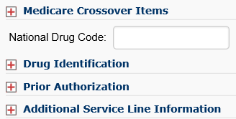
Line Level: Medicare Crossover Items, Drug Identification, Prior Authorization, and Additional Service Line Information
The following areas are not required for sign language billing.
27

Slide 28
Line Level: Service Details
Select the Add Service Line Item button to add the procedure line on the claim.
Note: Ensure all necessary claim information has been entered before clicking the button to add the service line to the claim, or you may get errors.
28

Slide 29
Update Service Line Items
To change a service line item select the number of the line that needs to be updated.
This will repopulate the service line item boxes for edits to be made.
Once the service line is updated, click the Update Service Line Item button to add corrected information to the claim

Slide 30
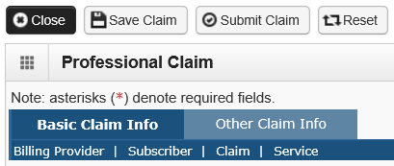
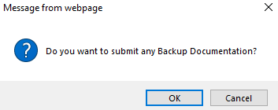
Submitting Claim for Processing
Click on the Submit Claim button on the top left header bar to submit your claim.
The following pop up window is displayed.
Click on the OK button to attach a copy of the paid invoice.
30

Slide 31
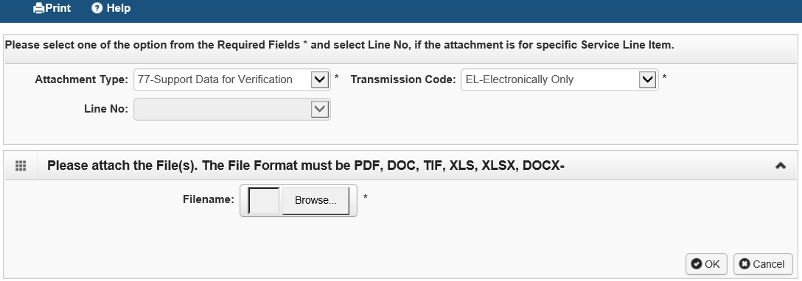
Submitting Claim for Processing
The Claims Backup Documentation page is displayed.
Enter the Attachment Type of 77-Support Data for Verification.
Enter the Transmission Code of EL-Electronically Only.
Click on the Browse button to choose the electronic file to attach.
Click on the OK button.
31

Slide 32
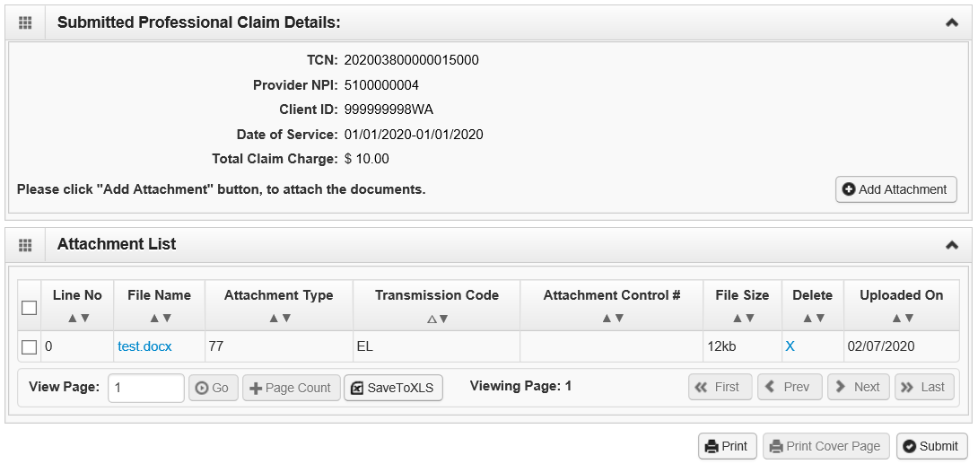
Submitting Claim for Processing
The Submitted Professional Claim Details confirmation page is displayed. It will display a summary of the basic claim information, as well as the assigned claim number (TCN).
ProviderOne will display the attached electronic record under the Attachment List section.
Click the final Submit button to send your claim to ProviderOne.
Notes:
This will take you to the ‘Submitted Professional Claim Details’ screen. When you are ready to submit your claim, you will click on the ‘submit’ button at the bottom right of the page.

Slide 33
Trouble Shooting Uploading Invoices
If you are unable to upload a copy of your paid invoice it could be because:
The naming convention has symbols
The document type is not recognized/accepted into provider one
There is a problem with the attachment
When submitting additional documentation in ProviderOne the following are acceptable file formats:
PDF, GIF, JPEG, DOC, DOCX, XLSX and document sizes no more than 10 MB.
Note: If you continue to have trouble uploading paid invoice please email Interpreter Services Inbox for assistance.

Slide 34
Resources
HCA Interpreter Services Program
Additional Resources
Contact
INTERPRETERSVCS@hca.wa.gov
ProviderOne
www.hca.wa.gov/billers-providers-partners/apple-health-medicaid-providers/enroll-provider
1-800-562-3022 Ext 16137
Additional Information
www.hca.wa.gov/isproviders
www.hca.wa.gov/sli-transition
ODHH
www.dshs.wa.gov/altsa/office-deaf-and-hard-hearing
1-800-422-3263
Note: Contact Interpreter Services for program and policy questions. Contact Provider Enrollment for provider file updates. Contact Provider Relations for DDE billing claims/templates or profiles.
34

