Slide 1
HIT Operational Plan Update May 26, 2020

Slide 2
Agenda
Telehealth Update 1
MH IMD Waiver
BH Provider Survey
Consent Management
PMP Update
UW FHIR App for PDMP Query
Master Person Index
Telehealth Update 2
Notes:
Brad

Slide 3
Telehealth Update 1

Slide 4
Telehealth
Telehealth has emerged as a critical tool to support delivery of needed services in response to the public health emergency
To support the use of telehealth for patients and by providers, HCA has made available:
Zoom licenses for providers
Loaner laptops for providers
Cell phones for patients and providers
Supported telehealth training and technical assistance through the Behavioral Health Institute

Slide 5
Zoom Licenses
The Zoom license program
Number distributed -1526 activated, 92 pending
Types of providers that received. For example:
BH - 1212
Community – 290 (including Dental)
Tribal providers – We have these, but don’t do separate counts
HCA Staff: 23
Number of licenses still available – 476

Slide 6
Loaner Laptop Program
The loaner laptop program
HCA implemented the loaner laptop program 4/8/2020
Number distributed: 278 (as of 5/20/2020)
Approximately 300 laptops remain available
Types of providers that received laptops:
BH
Dental
Medical
Tribal
See counts/geographic distribution next slide

Slide 7
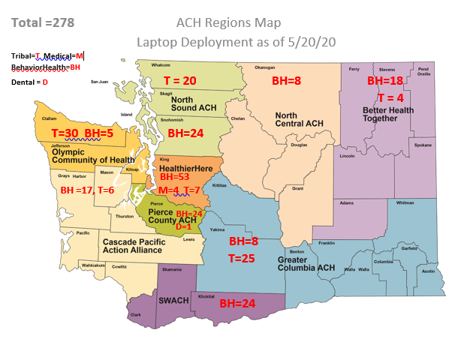
Loaner Laptop Program

Slide 8
Free Cell Phones
The free cell phones have been available for the last 2 months
HCA received and distributed a total of 6,000 cell phones (as of 5/21/2020)
The cells phones came with pre-paid monthly plans that support:
400 minutes
unlimited data/text
The phone plans are being paid for monthly through the end of the public health emergency.
At the end of the emergency the phones will be ‘released’ and recipients will have the option to purchase a pay as you go/prepaid plan through either Verizon/T-Mobile depending on which company donated the phones.
Types of patients/providers that received the phones were:
BH, FCS, Dental, Tribal, Area Agency on Aging, Free Clinics, Pediatric Clinics, DOC’s early release inmates with high-medical needs and who qualified for Medicaid

Slide 9
FCC's Lifeline Program: Discounts for Phone and Broadband Service
The Federal Communication Commission’s (FCC’s) Lifeline Program provides monthly discounts on phone and broadband service to qualifying low-income consumers. Many fixed (landline) Lifeline carriers already offer unlimited local and toll-free calling to their subscribers. Many mobile wireless Lifeline carriers are temporarily offering unlimited calling to subscribers during the COVID-19 pandemic. Find Lifeline carriers in your area: https://data.usac.org/publicreports/CompaniesNearMe/Download/Report https://data.usac.org/publicreports/CompaniesNearMe/State/StateOption/WA Qualifying individuals: https://www.lifelinesupport.org/do-i-qualify/ More information on the program and how to apply: https://www.lifelinesupport.org/
Notes:
Washington State cell phones carriers will provide Lifeline services to eligible clients
Lifeline is the Federal Communications Commission’s (FCC's) program to make communications services accessible to low-income consumers. Lifeline provides subscribers a discount on monthly telephone service, broadband Internet access service, or voice-broadband bundled service purchased from participating providers.
Lifeline is available to eligible, low-income consumers in every state, commonwealth, territory, and on Tribal lands. The Lifeline program is administered by the Universal Service Administrative Company (USAC). USAC is responsible for data collection and maintenance, support calculation, disbursements, and assisting consumers with Lifeline eligibility and enrollment for the program.
The following Lifeline service providers are active in Washington:
Access wireless
Assurance wireless
Budget mobile
enTouch wireless
Life wireless
Safelink wireless
Yourtel wireless
How do people apply for the lifeline?
Federal regulations (47 CFR Part 54, sec. 54.400) allow one Lifeline subsidy per household. This means that client must choose whether they want the subsidy applied to a landline or cell phone.
Landline
Contact your local landline phone service provider and request a Lifeline Application. If you are eligibility, the local phone company will apply Lifeline subsidy to your phone bill.
Cell phone
You must apply with a Lifeline cell phone provider in Washington. After you complete your phone company’s application for Lifeline services, you will receive a cell phone by mail if you are eligible.

Slide 10
Behavioral Health Institute (BHI)
HCA/DBHR is supporting BHI activities to respond to rapid behavioral health (BH) telehealth deployment and training and technical assistance during the public health emergency.
BHI is supporting statewide coordination and mobilization in partnership with providers, HCA/DBHR, MCOs, ACHs, UW and others
Near-term focus:
continuity of operations; supporting access to care, equipment, technical assistance, billing; and staff/client training.
training to address workflow, clinical supervision training and support, and policy/procedure development
survey on BH organizations use of telehealth / telephone
analysis of regulatory and other changes that have been implemented to support telehealth
creating a sub-committee on broadband
Long-term focus:
digital health more broadly
To learn more: https://bhi-telehealthresource.uwmedicine.org/

Slide 11
MH IMD Waiver

Slide 12
1115 MH IMD Waiver Submission
HCA submitted an application for an amendment to the 1115 Demonstration waiver in order to add a 5th initiative.
This waiver opportunity would allow the state to claim federal matching funds for services in an IMD that has an average length of 30 days or less.
CMS has conditions that include budget neutrality and overall MH system improvements.
HIT system capabilities/improvements are required as part of the implementation plan and milestones that must be met

Slide 13
2020 HIT Operational Plan Activities
MH IMD Waiver Health IT Requirements include:
Closed loop referrals and e-referrals
electronic care plans
Medical records transitions
E-Consent for sharing sensitive health care information consistent with applicable law and regulations
interoperable intake, assessment and screening tools
Telehealth
Linking health care information to the correct patient
Risk identification
Notes:
The MH IMD Waiver includes HIT requirements related to: e-care plans, closed loop referrals and e-referrals, transition of medical records (as individuals transition between systems of care), e-consent, interoperable intake, assessment and screening tools, telehealth, at risk for stopping treatment, identity management, and electronic records across all episodes of care.

Slide 14
Challenges
Funding
Integration—the capabilities and requirements necessary for the 1115 MH waiver aren’t that different from what is needed for the rest of the system

Slide 15
BH Provider Survey

Slide 16
Update
2020 Behavioral Health Provider Survey
Web survey was launched on April 17, 2020.
Population consists of DoH-certified, community-based mental health (MH) and substance use disorder (SUD) treatment agencies providing publicly funded services in Washington state (n=618).
Survey invitation was sent to agency administrators or directors by first-class mail with link to the survey and unique secure PIN.
As of May 26, 2020: 211 completed and 40 partially completed surveys with raw response rate of 40.6% (251/618).
Survey section on EHR has 16 main questions.
Question on EHR functionalities has 21 sub-questions.
Link to the survey: www.opinion.wsu.edu/ProviderSurvey2020

Slide 17
Consent Management

Slide 18
Navigating Patient Consent
HCA led a SUD work group last year
Published guidance for interpreting 42CFR Part2
“Sharing Substance Use Disorder in Washington State.”
Follow-up ECM Project (Phase I ends Sept 2020)
Part 1: Electronic Consent Business & Technical Requirements
Part 2: Whole Person Care discussions
(barriers to data exchange, awareness of current resources & support for implementing workgroup guidance)
Notes:
?

Slide 19
Part 1: Electronic Consent Business & Technical Requirements
Six cohorts will be completed this week to develop requirements for an electronic consent solution
Partnering with Comagine Health
Next step: will seek funding in late 2020 to pilot an electronic consent management tool (Phase II)

Slide 20
Participating Organizations
Consejo Counseling
Peninsula Community Health Services
Olalla Treatment Center
Metropolitan Development Council
Multicare Behavioral Health
Comprehensive Healthcare (Yakima)
CHC Tacoma
Comprehensive Life Resources
Evergreen Recovery Centers
DOC, SCORE, Kitsap County Jail

Slide 21
Part 2: Whole Person Care Discussions
Ten sessions will be convened in the next couple of months
Goal is one per ACH
Tribal session in July
Purpose: to discuss guidance implementation, barriers to data exchange and resources needed to assist
Partnering with Comagine Health
Next step: develop webinars and toolkit for providers

Slide 22
PMP Update

Slide 23
PMP Upgrade Update
PMP upgraded from RxSentry to AWARxE on 5.5.2020
Initial issues for first hour, then resolved
Upgrade benefits
Latest system, better reports, user friendly
Ongoing issues
401 errors, SAW access, Query limits
For assistance
prescriptionmonitoring@doh.wa.gov, 360-236-4806 or 4869

Slide 24
FHIR App for PDMP Query

Slide 25
COSRI
Clinical Opioid Summary
for Rx Integration
University of Washington
May 2020
Seth Wolpin, PhD - Bill Lober, MD
https://project.cosri.app
In collaboration with:
THE UW COSRI TEAM
Donna Berry, Paul Bugni, Amy Chen, Ivan Cvitkovic, Maggie Dorr, Jan Flowers, Andrea Fourquet, Sierramatice Karras, Jenney Lee, Bill Lober, Justin McReynolds, Jennifer Sprecher, Seth Wolpin

Slide 26
PRESCRIPTION DRUG MONITORING PROGRAM (PMP)
WA State Opioid Response Plan: To use data to detect opioid misuse.
WA State PMP database houses statewide dispensing records for Schedule II, III, IV and V drugs.
2019 UW survey of providers found low adoption of PMP data use due to cost and integration barriers.
2019 Legislature Report calls for enhanced decision support.
Notes:
As one of the priority goals in the WA State Opioid Response Plan – to use data to detect opioid misuse – WA State implemented the PMP database to house statewide dispensing records for Schedule II, III, IV and V drugs
WA State PMP database houses statewide dispensing records for Schedule II, III, IV and V drugs.
UW survey found adoption of PMP data use could increase by reducing barriers to accessing and using the PMP, such as PMP-EHR integration.
Legislature report calls for enhanced decision support to improve identification of patients who may have had a previous overdose.

Slide 27
Overarching funding to improve PMP usage comes from the CMS Support ACT through the Washington Healthcare Authority.
As part of that WHA project, Washington State Department of Health (DOH) has partnered with UW CIRG to improve the access to and utility of information in the WA PMP.
WHO & WHY
Integrated application for accessing PMP.
Provides decision support based on WA rules and CDC guidelines, and decreases overhead and cost barriers associated with vendor-based EHR-integrated applications.
Open source, no license fees to use.
COSRI extends and contextualizes software from CDSConnect project, led by AHRQ and CDC.
WHAT
Notes:
COSRI is an integrated application for accessing the PMP
Integrated means used within your workflows and within your existing technology, such as an EHR integration.
One of our main focuses with COSRI is to provide rural and smaller clinics access to the PMP, provide decision support based on Washington State rules and CDC guidelines, and decreases the overhead and cost barriers associated with vendor-based EHR-integrated applications.
AHRQ and CDC - contextualize work to state level rules.
Although COSRI can be used as standalone software – independent from an EHR - what you’ll see today is a demonstration of what the it looks like when integrated into an EHR as part of the clinical workflow.

Slide 28
GUIDELINES AND RULES
CDC GUIDELINES
WASHINGTON RULES
Focus on chronic pain patients
Opioids are not first-line therapy
Establish goals for pain and function
Discuss risks and benefits
Use immediate-release opioids when starting
Use the lowest effective dose
Prescribe short durations for acute pain
Evaluate benefits and harms frequently
Use strategies to mitigate risk
Review PDMP data
Use urine drug testing
Avoid concurrent opioid and benzodiazepine prescribing
Offer treatment for opioid use disorder
More nuanced with complexities and slight variations –
Focus on phases of pain, not just chronic
Focus on ambulatory care is the same, but with a slightly different patient exclusion criteria
Co-prescribing rules in WA include more than just benzodiazepines – also barbiturates, Soma, and other sedative-hypnotics (CDC #11)
PMP Access requires more specific steps and documentation in WA (CDC #9)
For chronic pain patients, WA rules allow a higher MED than the CDC guidelines (120 vs. 90)
WA requires screening for prior overdoses, which comes from the EHR data
Notes:
One of the main purposes of building this application is to help providers follow best practice in prescribing, and to adhere to local Washington State rules.
We incorporate some of the CDC guidelines, and the WA rules where they override or are additional requirements.
For example, in CDC #3, we include a notification if there is no prescribed stool softeners or laxative AND at least one opioid medication is present.
The WA rules are a lot more nuanced, with a focus on phases of pain instead of just chronic (Acute, Perioperative, Subacute, +Chronic)
In certain cases we’ve had to build in the differences, such as notifications about exclusions, or co-prescribing checks and notifications.
Our app gives preference to WA rules when both CDC and WA are addressing a situation
Computerized decision support, such as in COSRI, helps navigate these differences without having to do mental gymnastics to determine what they should be doing

Slide 29
QUEUING THINGS UP
Imagine you are with a patient, medical record is open in your EHR…
Test Jackson, M, 51
Mr. Jackson is a general contractor who has serious chronic back pain from a work-related injury years ago. He also experiences intense anxiety at times. His primary health goal is to keep his pain and anxiety under control so that he can continue to work. He has tried physical therapy and other treatments, but continues to come to the clinic for pain control.
WA State rules require providers review PMP data for prescribing.
Feedback encouraged throughout the demo…
Notes:
After talking with him today, you want to determine what the best prescription is for him to achieve his health goal.

Slide 30
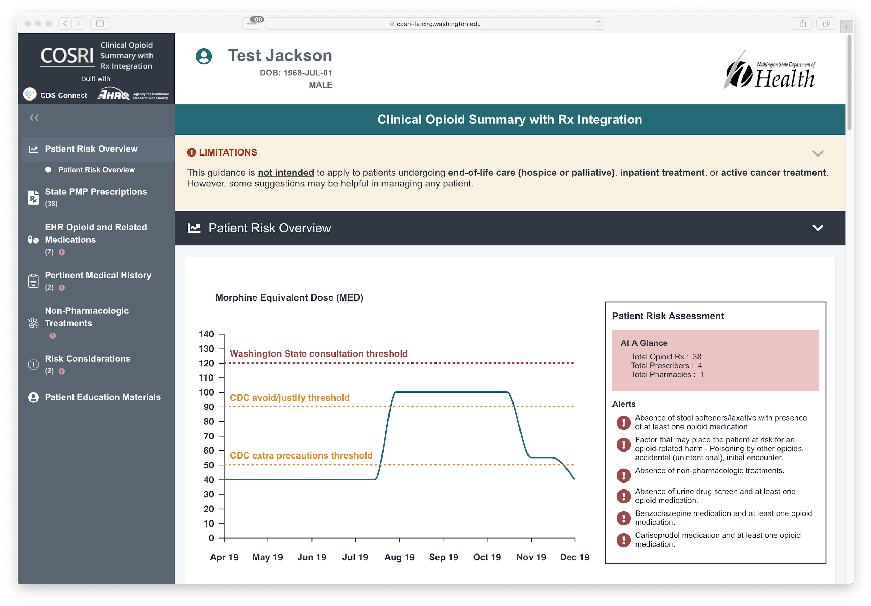
COSRI
Notes:
AHRQ Pain Management Summary App
SoF, OpenSource, CQL for CDS (Maggie’s talk)
For HIMSS -
SoF app, integrated PMP queries using NCPDP 10.6
Launched from Epic
Part of CDC’s IHE Opioids scenario
This version is a bit further along that what we had at HIMSS - and it’s actually the Risk Overview panel that’s new, much of the rest is the way we

Slide 31
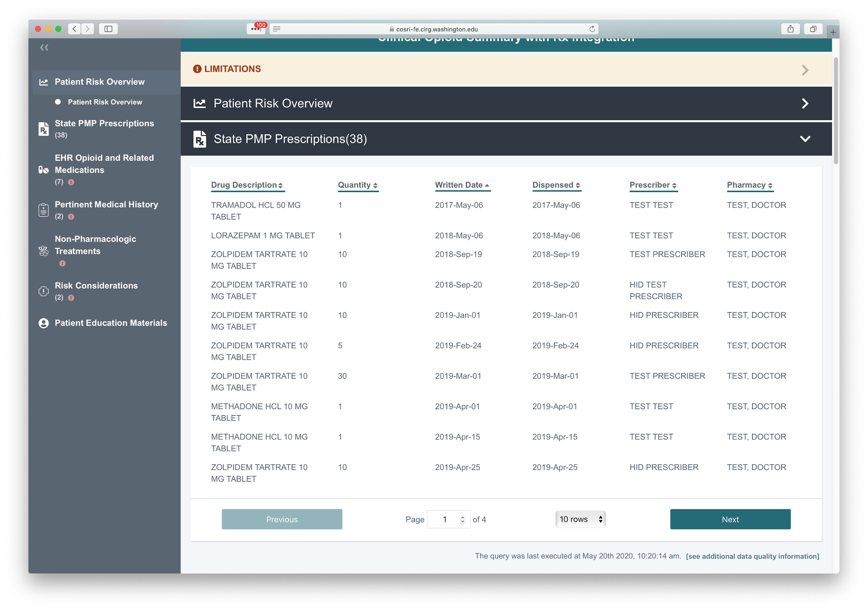

Slide 32
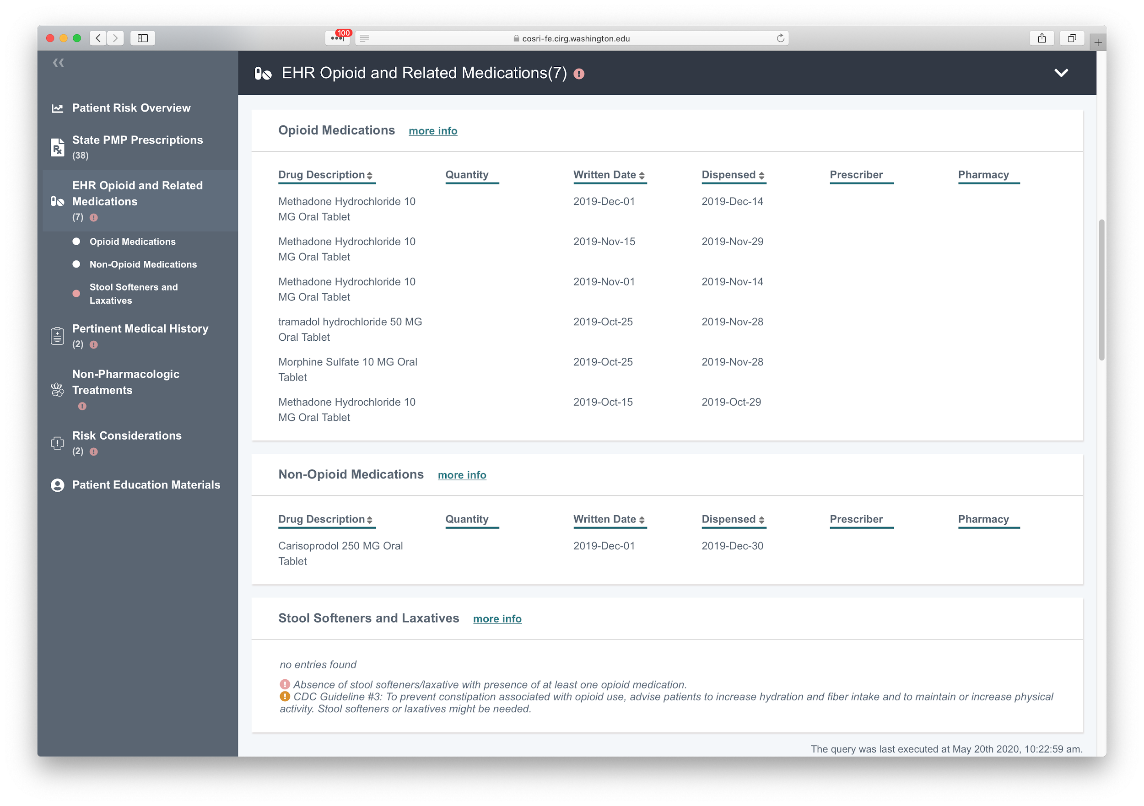

Slide 33
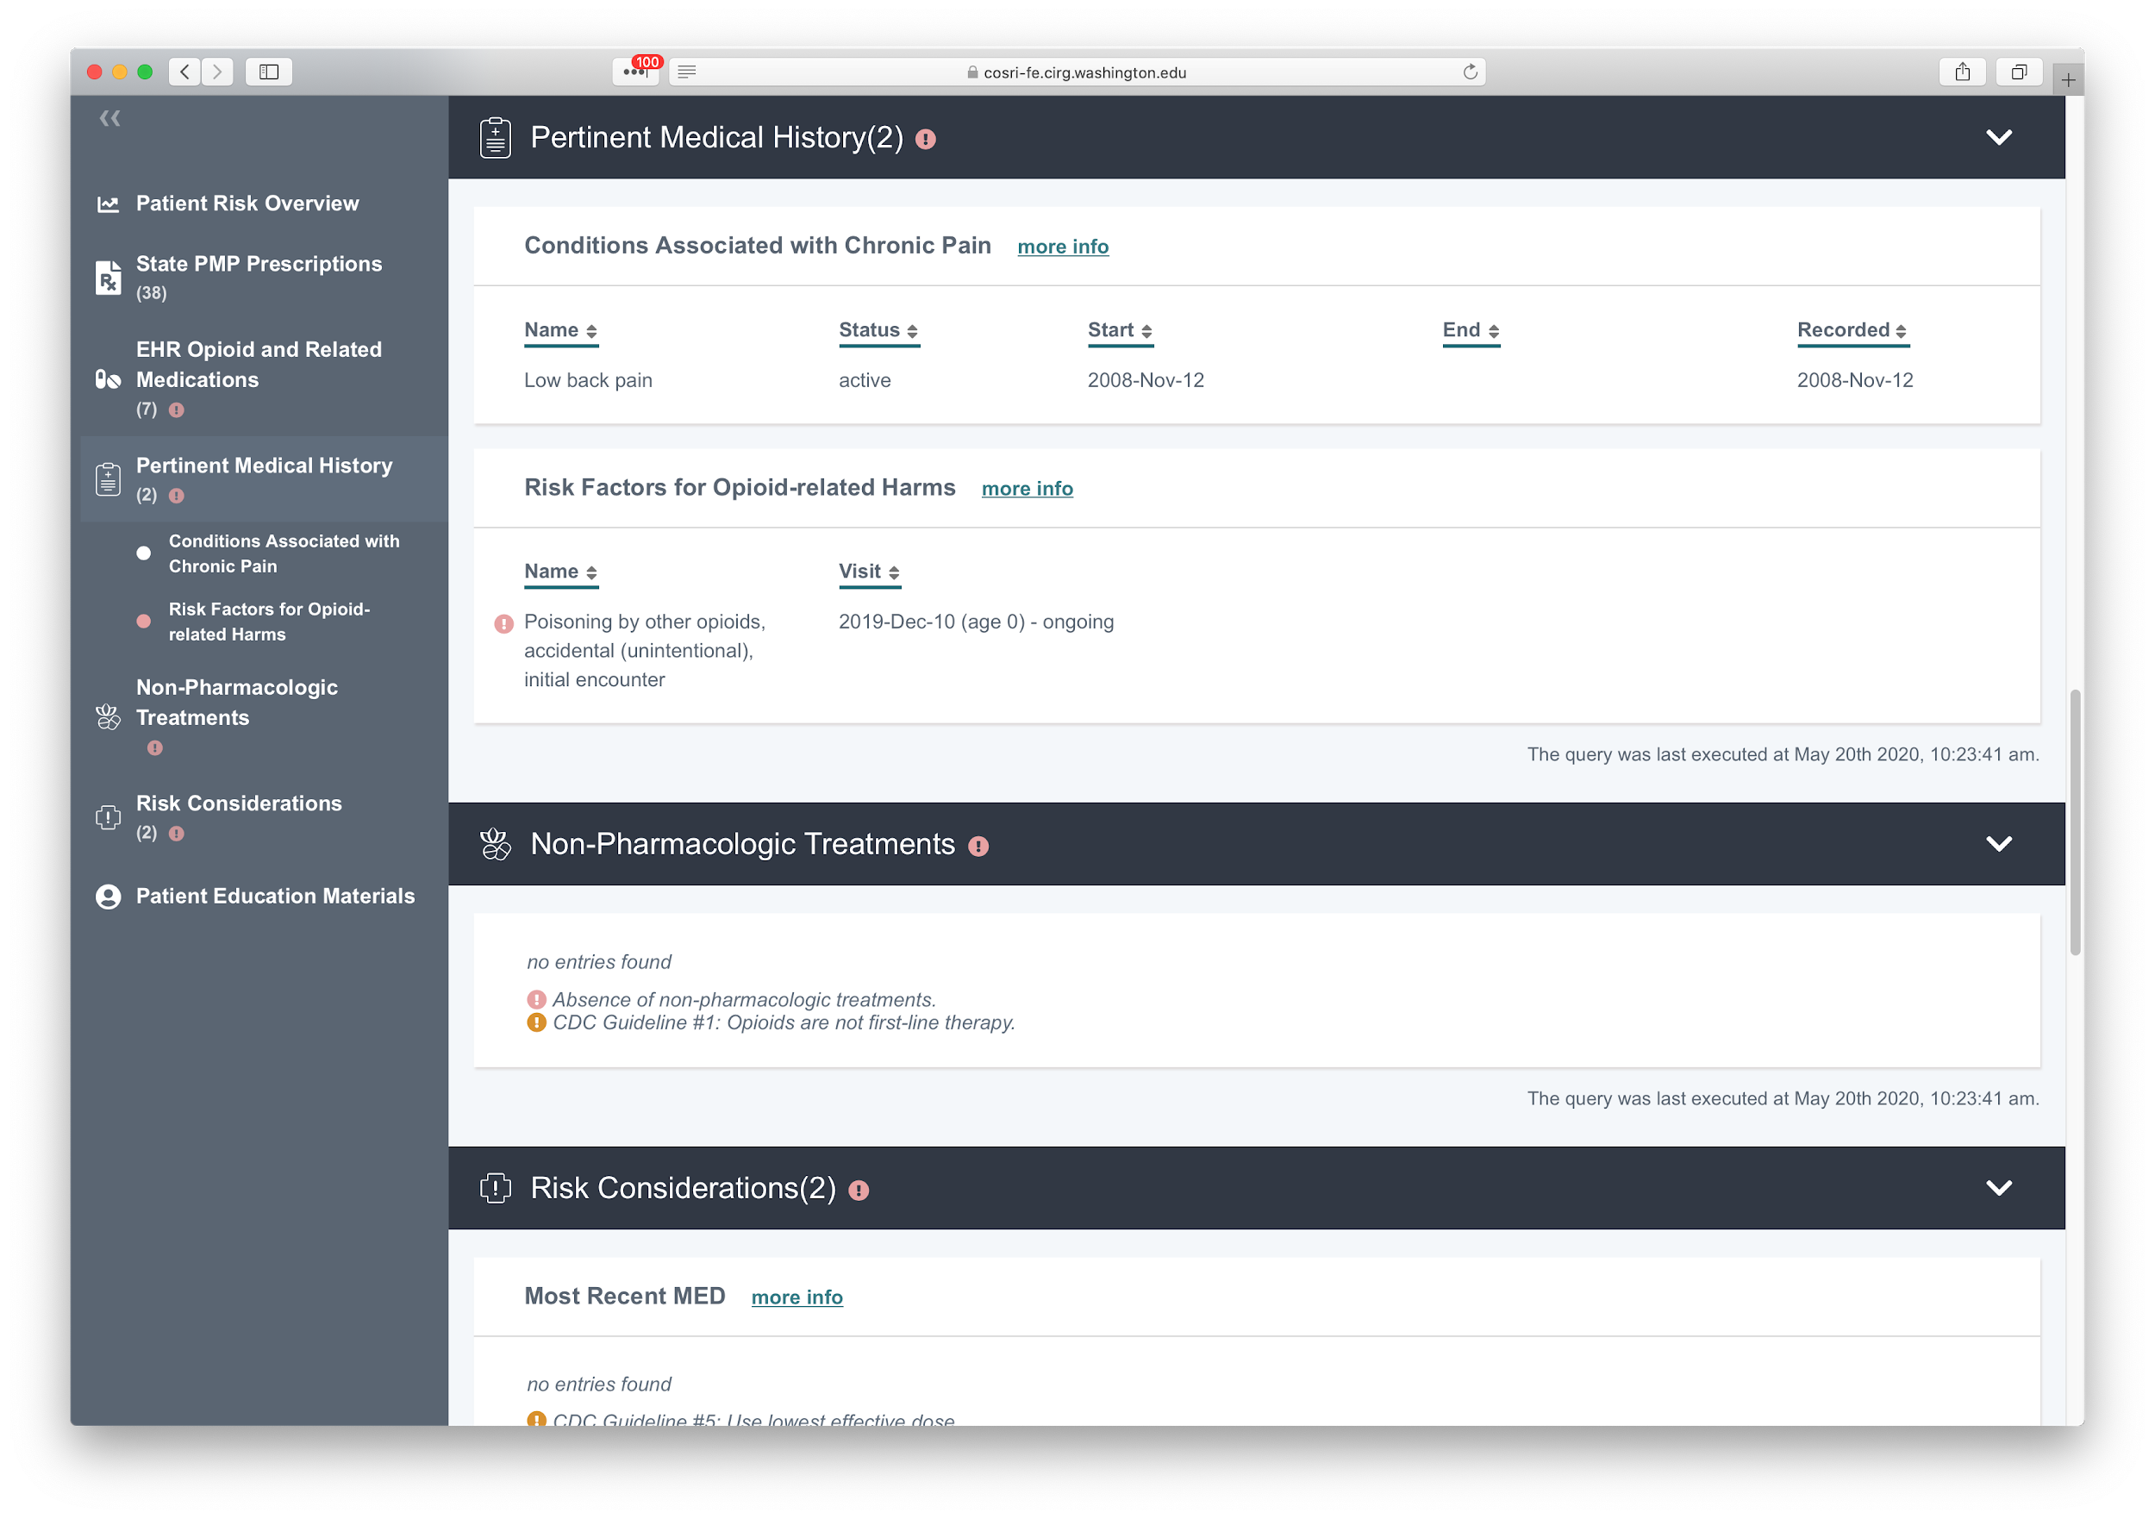

Slide 34
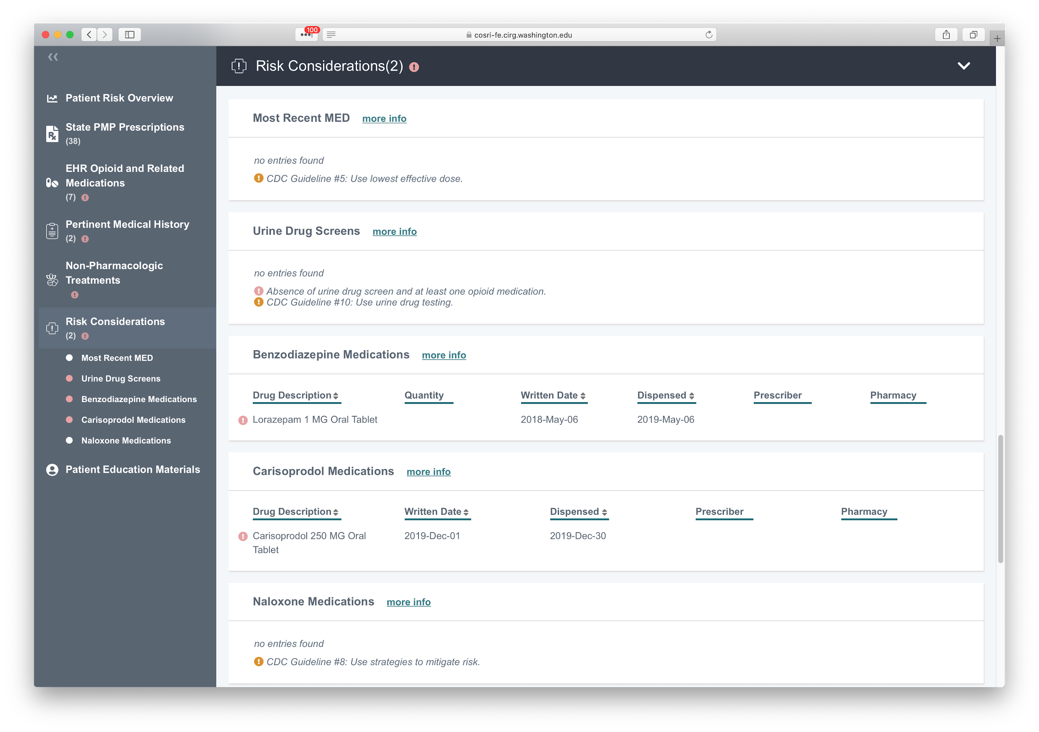

Slide 35
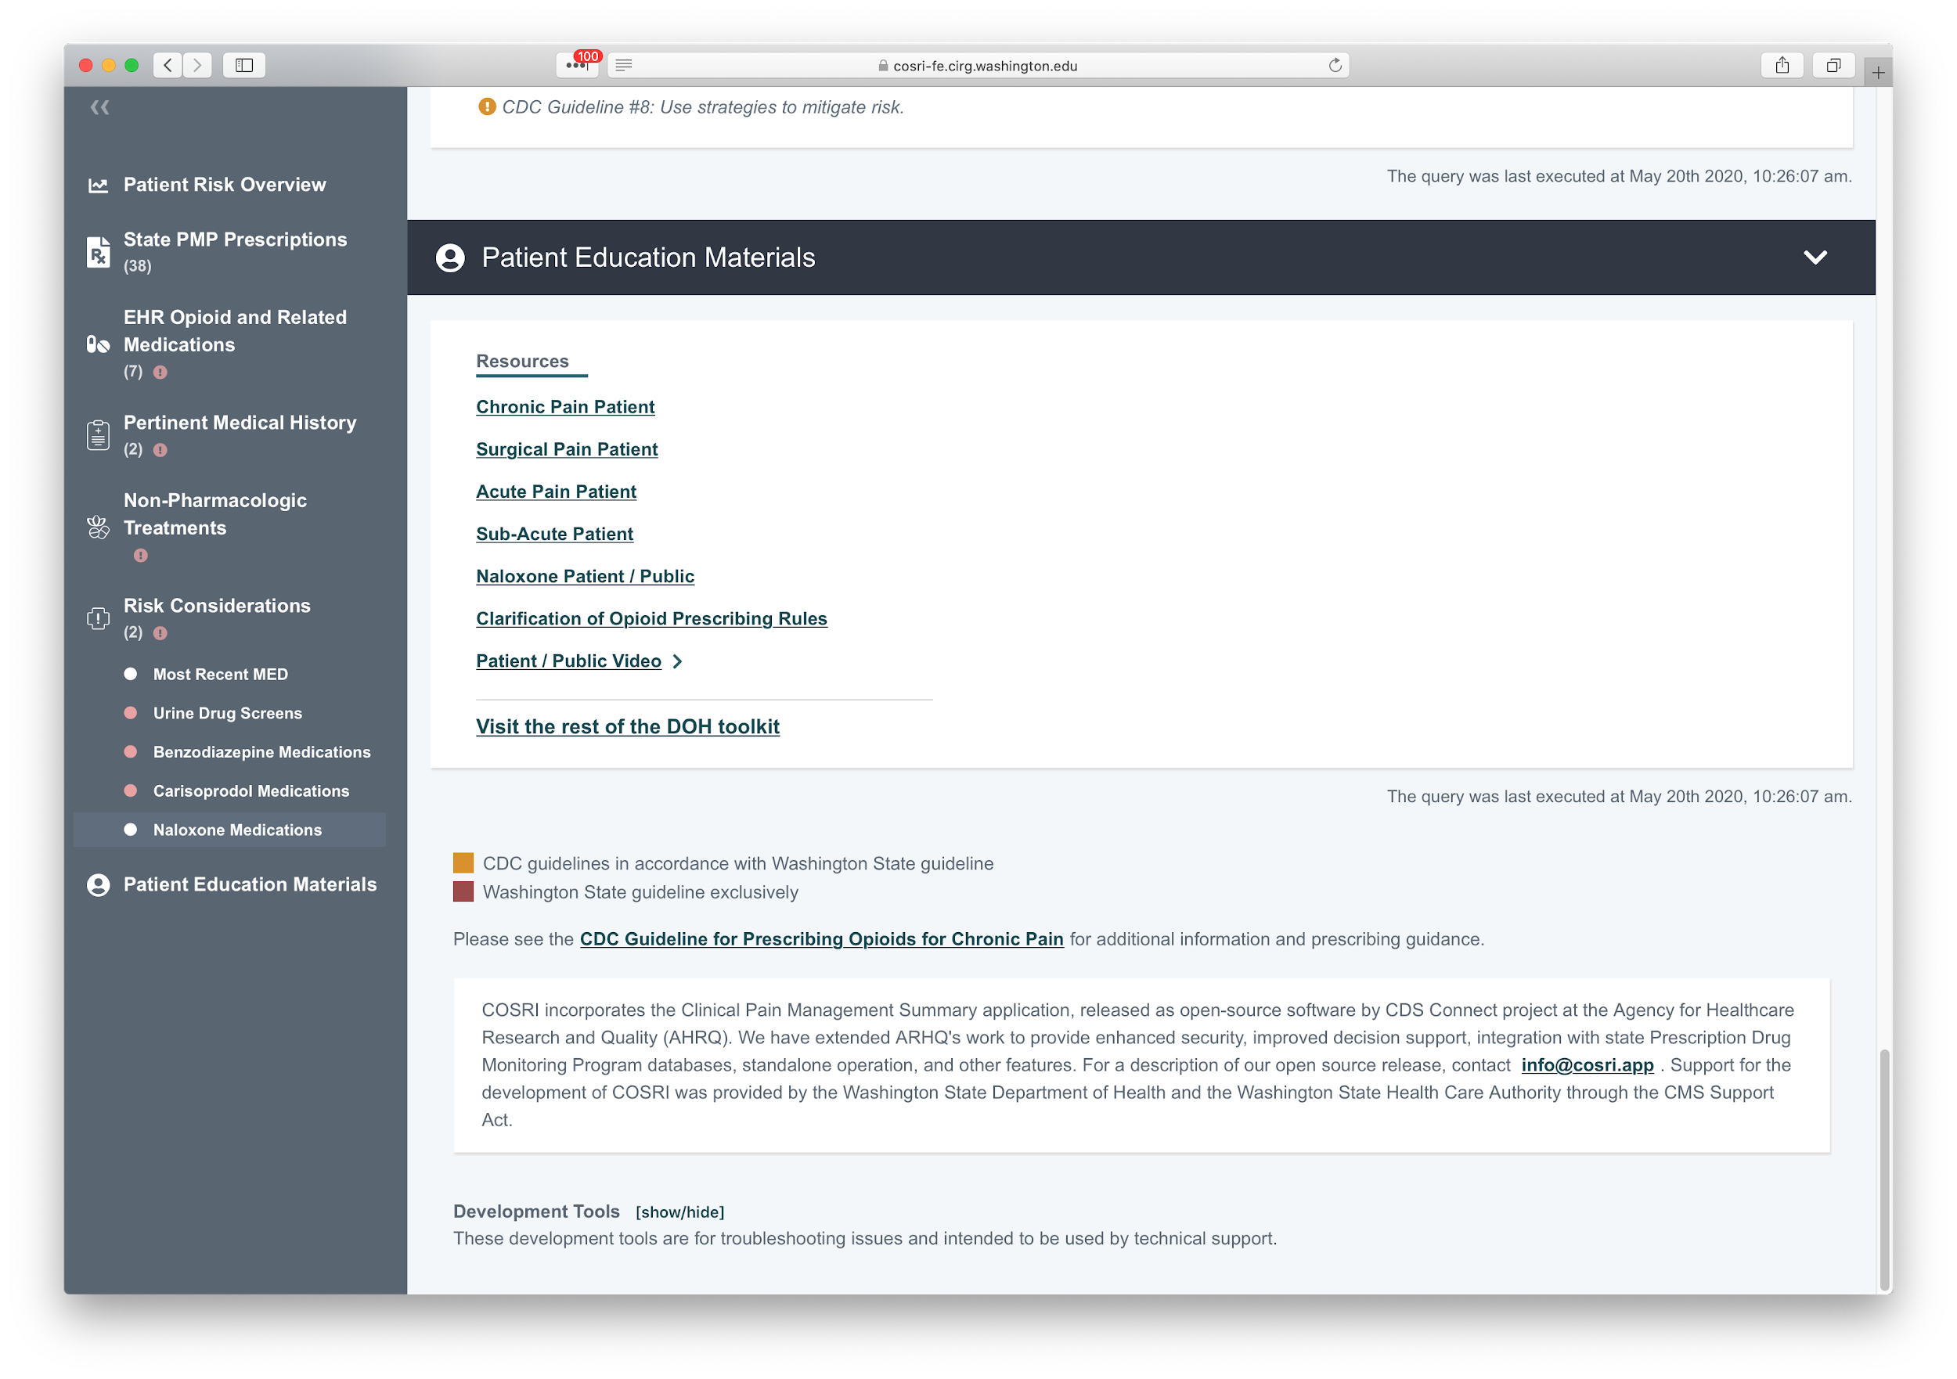

Slide 36
WHY EARLY ADOPTERS, AND HOW WE’LL USE THEIR INPUT
Prototype with
Epic Integration
Early Adopters
Engaging early adopters to help us identify priorities for the first release
Software release and support for use in clinical workflows for early adopters and more input
Iterative prioritized improvements identified by early adopters
Provider Survey
2019
HIMSS (MAR)
MAY
JULY
FUTURE

Slide 37
Questions?
Comments?
swolpin@uw.edu
lober@uw.edu
https://project.cosri.app

Slide 38
Master Person Index

Slide 39
Master Person Index
The HHS Coalition MPI project has two companion efforts:
MPI Accelerator Proof of Concept
Demonstrate the capabilities of an MPI technical solution
Identify the key decisions necessary to implement a multi-agency MPI and gain experience with governance
Create a technical solution to address an immediate MPI COVID related use case
MPI Planning Phase:
Incorporate learnings from the Proof of Concept into the planning phase
Document the MPI Roadmap
Document MPI requirements
Develop MPI Governance processes

Slide 40
Telehealth Update 2

Slide 41
HCA Telehealth Resources
Apple Health (Medicaid) telemedicine & telehealth brief: https://www.hca.wa.gov/assets/billers-and-providers/telehealth-brief-for-COVID-03-2020.pdf
HCA offers limited number of no-cost telehealth technology licenses for providers: https://www.hca.wa.gov/hca-offers-limited-number-no-cost-telehealth-technology-licenses-providers
HCA statement on security in telehealth technology: https://www.hca.wa.gov/hca-statement-security-telehealth-technology
Apple Health (Medicaid) telehealth policy (4/30/2020):
slide deck: https://www.hca.wa.gov/assets/apple-health-telehealth-webinar-4-30-2020.pdf
recorded webinar: (4/30/2020): https://www.youtube.com/watch?v=DsCl9SRMq-g&feature=youtu.be

Slide 42
HCA Telehealth Resources
Behavioral Health: Telehealth technical assistance for providers (recorded): https://www.youtube.com/watch?v=Qgtt5e8bv54&feature=youtu.be
DBHR COVID-19 weekly call (updated 4/14/2020)
https://www.hca.wa.gov/assets/program/covid-19-call-20200413.pdf

Slide 43
HCA Telehealth Resources
For COVID-19 billing, coding, or telehealth policy questions: HCAAH_COVID19@hca.wa.gov​
Telehealth guidance for Apple Health clients: https://www.hca.wa.gov/assets/free-or-low-cost/telehealth-guidance-apple-health-clients.pdf

Slide 44
Bi-Monthly HIT Operational Plan Meetings
4th Tues. of every other month.
Next meeting: July 28
Same webinar, phone number, meeting room. Available at:
https://attendee.gotowebinar.com/register/6533460124218503425
Notes:
Brad

Slide 45
Questions?
More Information:
Bi-monthly updates will be posted on HCA Transformation website.
https://www.hca.wa.gov/about-hca/health-information-technology/washington-state-medicaid-hit-plan
Jennie Harvell,
Health IT Section
jennie.harvell@hca.wa.gov

